Slide 1
Digital Portfolio
STUDENT NAME: Kiruthiga S
REGISTER NO AND NMID: asanm22122124ubca012
DEPARTMENT: BCA
COLLEGE: St Ann’s College of Arts and Science tindivanam.

Slide 2
STUDENT PORTFOLIO
A student portfolio is a compilation of academic work and other materials that showcase a student's learning, progress, and achievements over a period of time. It's like a personalized exhibit of a student's educational journey.

Slide 3


AGENDA
Problem Statement
Project Overview
End Users
Tools and Technologies
Portfolio design and Layout
Features and Functionality
Results and Screenshots
Conclusion
Github Link
3/21/2024 Annual Review

Slide 4
PROBLEM STATEMENT
In the context of a student portfolio, a problem statement typically refers to a concise description of a specific issue, challenge, or opportunity that a student has addressed or explored through their work. It's particularly relevant when the portfolio showcases projects, research, or solutions to real-world problems.

Slide 5

PROJECT OVERVIEW
In a student portfolio, a project overview serves as a concise summary or introduction to a specific project. It's designed to give the viewer a quick but comprehensive understanding of the project's essence without them having to delve into all the details immediately.

Slide 6

WHO ARE THE END USERS?
The context of a student portfolio, end users are the people who will view, evaluate, or benefit from the portfolio. They are essentially the audience or recipients of the portfolio's content.
Students | Self-reflection, personal growth, planning
Admissions Officers | Evaluating student fit for programs
Parents/Guardians | Monitoring student progress
Employers | Hiring, internships, showcasing skills
Peers | Feedback, collaboration
Teachers/Instructors | Assessment, grading, feedback

Slide 7

TOOLS AND TECHNIQUES
Tool Type | Examples | Purpose
Digital Platforms | Google Sites, Wix, WordPress, Canva, Notion | Create and publish digital portfolios
Learning Management Systems (LMS) | Google Classroom, Moodle, Microsoft Teams | Store and organize student work
Document Tools | Google Docs, Microsoft Word, PDFs | Create written reflections or assignments
Presentation Tools | PowerPoint, Google Slides, Prezi | Present the portfolio to an audience
Multimedia Tools | YouTube, Adobe Creative Cloud, Audacity | Add video, audio, or design content
Portfolio Software | Seesaw, Mahara, Portfolium | Platforms specifically for student portfolios
TOOLS:

Slide 8
Techniques
Technique | Description
Reflection Writing | Writing about what was learned, how it was learned, and why it matters
Goal Setting | Including personal or academic goals to show progress over time
Self-Assessment | Students evaluate their own work to show growth and understanding
Curation | Selecting the best or most representative work to include
Annotation | Adding notes or captions explaining the significance of the work
Storytelling | Using narrative to connect pieces of work into a meaningful journey
Visual Organization | Designing layout and structure for easy navigation and appeal

Slide 9
POTFOLIO DESIGN AND LAYOUT
[Header with Logo or Name]
| Home | About Me | Projects | Reflections | Resume | Contact |
------------------------------
| Hero Image or Welcome Text |
------------------------------
[Project Gallery]
[Each item clickable to a detailed page with description + images/videos]
[Footer: Name | Email | LinkedIn | School Name]
9

Slide 10
FEATURES AND FUNCTIONALITY
Features:
Homepage with welcome message
About Me with goals and hobbies
Project Gallery with images and descriptions
Reflections blog
Resume (downloadable)
Contact form
Functionality:
Editable via Google Sites
Mobile-responsive
Embedded YouTube video
of a presentation
Private until published,
with a shareable link

Slide 11
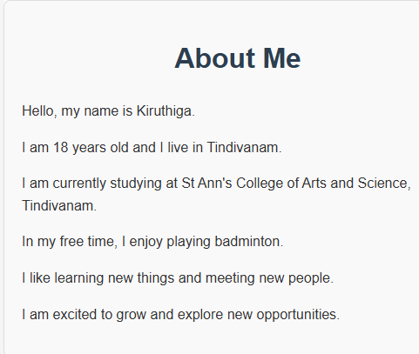

RESULTS AND SCREENSHOTS
3/21/2024 Annual Review
11

Slide 12
CONCLUSION
A student portfolio is more than just a collection of work—it's a comprehensive showcase of learning, growth, skills, and achievements. When thoughtfully designed, it becomes a powerful personal and academic tool that reflects the student’s journey and potential.
12

Slide 13
GITHUB Link:
https://github.com/kiruthiga2327-create/Kiruthiga-TNSDCFWD-DP.git

